Slide 1
Software Development Tools
COMP220
Seb Coope
Ant, Testing and JUnit
Capturing test results
These slides are mainly based on “Java Development with Ant” - E. Hatcher & S.Loughran. Manning Publications, 2003

Slide 2
Capturing test results
The <junit> task can collect test results by using formatters.
One or more <formatter> elements can be nested
either directly under <junit>
or under the <test> (and <batchtest> to be discussed soon)
Ant includes three types of formatters:
brief,
plain,
xml
Notes:
4.6.1

Slide 3
Capturing test results
Ant <junit> task result formatter types
--------------------------------------------------------------------------------------------------------------------
<formatter> type Description
==================================================================
brief Provides details of each test case run with summary statistics on numbers
of its Test method runs, Failures, Errors, and overall Time elapsed,
and also details on each failed test method , all of this in text format
If usefile="true", each test case generates its own txt file.
plain Like formatter brief, and additionally the time taken by each test
method run (not only by those failed) , all of this in text format .
If usefile="true", each test case generates its own txt file.
xml Like formatter plain, and additionally date/time of testing and
Ant’s properties at this time, all of this in XML format
If usefile="true", each test case generates its own XML file.
-------------------------------------------------------------------------------------------------------------------
To avoid duplication on the console of the summary statistics on test results, switch off printsummary attribute:
<junit haltonfailure= "false" printsummary="false">
haltonfailure="true" would restrict the information of the above formatters to the first failure.
Notes:
, system out, and system error output of each test case.

Slide 4
Capturing test results
By default, <formatter>’s output is directed to files (usefile="true"),
but can also be directed to Ant’s console (usefile="false").
Update our target test-brief in mybuild.xml (see Slide14 in Part 12. Ant and JUnit) by including in <junit>:
the build failure upon test failure (haltonfailure="true"),
brief console output
<formatter type="brief" usefile="false"/>, and
turned off the printsummary option to not duplicate with the output from the brief formatter
<target name="test-brief" depends="test-compile">
<junit haltonfailure="true" printsummary="false">
<formatter type="brief" usefile="false"/>
<classpath refid="test.classpath"/>
<test name = "org.eclipseguide.persistence.FilePersistenceServicesTest"/>
<test name="org.example.antbook.junit.SimpleTest"/>
</junit>
</target>
Run this target in mybuild.xml.
Notes:
COMPARE formatters brief, plain and xml
by varying and running this target.

Slide 5
Capturing test results
H:\Antbook\ch04>ant -f mybuild.xml test-brief
Buildfile: C:\Antbook\ch04\mybuild.xml
[echo] Building Testing Examples
<run of previous targets omitted>
test-brief:
[junit] Testsuite: org.eclipseguide.persistence.FilePersistenceServicesTest
[junit] Tests run: 5, Failures: 2, Errors: 0, Time elapsed: 0.031 sec
[junit] Testcase: testWrite(org.eclipseguide.persistence.
FilePersistenceServicesTest): FAILED
[junit] NOT WRITTEN???
[junit] junit.framework.AssertionFailedError: NOT WRITTEN???
[junit] at org.eclipseguide.persistence.FilePersistenceServicesTest.
testWrite(Unknown Source)
[junit]
[junit]
This produces the following output on testWrite and testRead :
Our message to ourselves, if testWrite FAILED
(continued)
Notes:
ant -f mybuild.xml test-brief

Slide 6
Capturing test results
[junit] Testcase: testRead(org.eclipseguide.persistence.
FilePersistenceServicesTest): FAILED
[junit] expected:<[One, Two, Three]> but was:<null>
[junit] junit.framework.AssertionFailedError: expected:<[One, Two, Three]> but was:<null>
[junit] at
org.eclipseguide.persistence.FilePersistenceServicesTest.
testRead(Unknown Source)
[junit]
[junit]
BUILD FAILED
C:\Antbook\ch04\mybuild.xml:157: Test org.eclipseguide.persistence.FilePersistenceServicesTest failed
Total time: 1 second
continuation: output on testRead:
As <formatter type="brief"> shows, assertions in testWrite and
testRead methods in FilePersistenceServicesTest failed.
Note that SimpleTest did not run since haltonfailure="true".

Slide 7
Capturing test results
Now we’re getting somewhere:
tests run as part of our regular build,
test failures cause our build to fail: BUILD FAILED
we get enough information to see what is going on.
By default, formatters write their output to files
either in the base directory of the build file,
or in the directories specified in the <test> or <batchtest> elements by their optional attribute todir.
But our choice usefile="false" causes formatters to write to the Ant console instead of writing to a file.
TRY also usefile="true". What will you see on console? And in the base directory C:\Antbook\ch04?
Notes:
todir attribute of <test> or <batchtest>: Directory to write the reports to

Slide 8
Capturing test results
Also, we turned off the printsummary option as it duplicates and interferes with the output in the console from the brief or plain formatter.
In case of usefile="true", it makes sense to turn on the printsummary (to the console).
xml formatter is better to use with usefile="true".
It generates a huge XML output by listing all Ant’s properties
The <junit> task allows using simultaneously more than one <formatter>, so you can direct results toward several formatters at a time, as in the example below.
Notes:
The formatter, shows only the most important information rather than line numbers tracing back into JUnit’s classes.
It’s worth noting that the stack trace shown is abbreviated by the formatter, showing only the most important pieces rather than line numbers tracing back into JUnit’s classes.

Slide 9
XML formatter
Saving the results to XML files lets you process them in a number of ways (e.g. transforming to HTML).
Our testing task and target now evolves to this:
<target name="test-xml" depends="test-compile">
<junit haltonfailure="true" printsummary="false">
<classpath refid="test.classpath"/>
<formatter type="brief" usefile="false"/>
<formatter type="xml"/>
<test todir="${test.data.dir}"
name= "org.eclipseguide.persistence.FilePersistenceServicesTest"/>
</junit>
</target>
To avoid duplication in console of summary statistics
C:\Antbook\ch04\
build\data
Add this as a NEW target in mybuild.xml
Notes:
mybuild.xml, target name=“test-xml”

Slide 10
XML formatter (cont.)
The effect of the above is to create an XML reports in the ${test.data.dir} (i.e., build/data) directory for each test case run.
In our example, we get in build/data one (it could be more) XML file named like (actually, one line)
TEST-org.eclipseguide.persistence.
FilePersistenceServicesTest.xml.
Note that for this to work we should use <mkdir> tasks in appropriate target test-init (besides the usual init target) to create all directories required for testing and test reports, including
build\data for XML reports and
build\reports to be used later for HTML reports.
Recall that you should use properties in mybuild.xml for all directories used.
TRY it:
C:\Antbook\ch04>ant -f mybuild.xml clean test-xml
and inspect the above xml file just generated.
<mkdir dir="${test.data.dir}"/>
<mkdir dir="${test.reports.dir}"/>
Notes:
ant -f mybuild.xml clean test-xml
Viewing System.out and System.err output???

Slide 11
Running multiple tests under <batchtest>
You can specify any number of <test> sub-elements in <junit> task,
but that is still time consuming for writing your build file,
indeed, each individual test case should explicitly be mentioned.
But, instead of individual <test> elements, you can use <batchtest> with a fileset containing non-fixed number of files.
This includes all your test cases without mentioning any one of them individually.
In this case there is no need to update the build file when adding new test cases as soon as they automatically occur in the fileset under <batchtest>.
That is why <batchtest> is better to use than multiple <test> tags.
Notes:
(here we do not mean the time of running it)
4.6.2
(i.e. appropriate testing .java classes into a directory) S

Slide 12
Running multiple tests under <batchtest>
TIP: Standardize the naming scheme of your JUnit test cases for
easy fileset inclusions,
and possible exclusions of helper classes (or abstract test case classes).
Thus, real Junit Test Cases should end with the suffix Test according to the normal convention-naming scheme.
For example,
FilePersistenceServicesTest and SimpleTest are our test cases, whereas
Any other helper and abstract classes (possibly used by test cases) should not have the suffix Test.
Notes:
(i.e. testing Java classes)
We use “TestCase” as the suffix for our abstract test cases.

Slide 13
Running multiple tests under <batchtest>
Create in mybuild.xml a new target "test-batch" with <junit> using <batchtest>:
<target name="test-batch" depends="test-compile">
<junit printsummary= "no" haltonfailure="no">
<classpath refid="test.classpath"/>
<formatter type="brief" usefile="false"/>
<formatter type="xml"/>
<batchtest todir="${test.data.dir}">
<fileset dir="${build.test.dir}"
includes="**/*Test.class"/>
</batchtest>
</junit>
</target>
Directory for
XML reports for each test case run
Running all test cases
in ${build.test.dir}
at any depth

Slide 14
Running multiple tests under <batchtest>
The includes="**/*Test.class" attribute above and our agreement on naming test cases ensures that only our concrete test cases are considered.
Now TRY
>ant -f mybuild.xml clean test-batch
If you choose haltonfailure= "yes", then included test cases will run in some order only until one of them fails.
All these really running tests, up to the first failing one, produce XML files .
Find out and open them in the directory
${test.data.dir}, i.e. build\data
<fileset dir="${build.test.dir}"
includes="**/*mpleTest.class"/>
Notes:
ant -f mybuild.xml clean test-batch
OMITTED:
What if we have test suite AllTests.class in ${build.test.dir}?
Will it run?
Passing non-JUnit, or abstract, classes to <junit>
Causes an ERROR
[junit] No runnable methods
OMITTED:
and again the same with the change
<fileset dir="${build.test.dir}"
includes="**/*mpleTest.class"/>
Do not forget to recover *mpleTest.class to *Test.class.
Passing non-JUnit, or abstract, classes to <junit> results in an error.
OMITTED:
-Dbuild.debug=on
OMITTED:
All these running tests, including the last (failing) one produce XML files.
TRY to confirm this on examples.
Say, create also CopyofSimpleTest.java.

Slide 15
Notes on Terminology
Unfortunately the terminology of various textbooks on Ant on of our lectures differs from that used in the in Ant’s console output:
Our Test Cases are called Testsuites in Ant’s console output.
Our Test Methods are called Tests in Ant’s console output.
Notes:
4.7

Slide 16
Generating (HTML) test result reports
With test results written to XML files, it is straightforward to generate HTML reports (by using XSLT).
The task <junitreport> generates HTML reports :
it aggregates all individual XML files (for each Test Case) generated from <test> or <batchtest> into a single XML file named, by default, as
TESTS-TestSuites.xml
and then applies an XSL transformation to this file to get HTML report by using <report> sub-task.
Notes:
4.7

Slide 17
Generating (HTML) test result reports
Generating HTML report consists of:
placing the <junitreport> task
immediately following the <junit> task (in the target test-batch described above):
XML files, in ${test.data.dir}
are aggregated in the same directory into one XML file
and transformed to
<junitreport todir="${test.data.dir}">
<fileset dir="${test.data.dir}">
<include name="TEST-*.xml"/>
</fileset>
<report format="frames"
todir="${test.reports.dir}"/>
</junitreport>
(or "noframes")
HTML files in ${test.reports.dir}
= XSLT transformation done by <report> sub-ask

Slide 18
Generating (HTML) test result reports
We aggregate all generated
"TEST-*.xml" files
since that is the default naming convention used by the XML formatter of <junit>.
Then HTML report is created according to the <report> sub-element.
But it will not work if haltonfailure="yes" and some test case fails.

Slide 19
Generating (HTML) test result reports
Add the above <junitreport> task in test-batch target immediately after closing </junit> tag and before end tag </target>.
Put temporary haltonfailure="yes"
RUN it:
ant -f mybuild.xml clean test-batch
Was <junitreport> task started working to create HTML report in build/test/report?
Put haltonfailure="no" , try again and compare the results.
How can you explain the difference?
Was HTML report created now in build/test/report?
But again, BUILD SUCCESFUL whereas some tests FAILED!?
Everything looks good, except the last, not very natural point
Notes:
ant -f mybuild.xml clean test-batch
OMITTED:
-Dbuild.debug=on
OMITTED:
(Instead of -Dbuild.debug=on we could set this property in mybuild.xml)

Slide 20
Generating all test reports and enforcing the build to fail in case of failures
We know that haltonfailure="yes" forces build to fail and, actually, to halt if any of the tests fails.
But this does not allow to create
all TEST-*.xml files,
the aggregated TESTS-TestSuites.xml file, and
the HTML report.
As a solution,
turn off haltonfailure in order for the XML and HTML reports to be generated as above before the build halts, and additionally,
enforce build failure, after generating XML and HTML reports, by setting a specified property test.failed upon a test failure or error:
use the failureProperty and errorProperty attributes of the <junit> task, and
conditional <fail if="test.failed"> task.
Notes:
4.7.1

Slide 21
Generating all test reports and enforcing the build to fail in case of failures
Create new target test
<target name="test" depends="test-compile">
<junit printsummary="no"
haltonfailure="no"
errorProperty="test.failed"
failureProperty="test.failed">
<classpath refid="test.classpath"/>
<formatter type="brief" usefile="false"/>
<formatter type="xml"/>
<batchtest todir="${test.data.dir}">
<fileset dir="${build.test.dir}"
includes="**/*Test.class"/>
</batchtest>
</junit>
The most important target for Lab Test
test.failed is a property which is
set to true in case
of error or failure
As in
test-batch
above
This is only <junit> testing part
(<junitreport> part continued on the next slide)
Notes:
haltonfailure="no“ can be omitted at all since "no" is default

Slide 22
Generating all test reports and enforcing the build to fail in case of failures
<junitreport todir="${test.data.dir}">
<fileset dir="${test.data.dir}">
<include name="TEST-*.xml"/>
</fileset>
<report format="frames"
todir="${test.reports.dir}"/>
</junitreport>
<fail message="Tests failed. Check log and/or reports."
if="test.failed"/>
</target>
End of <junitreport> creating part
Conditional <fail> task
enforcing build to fail
(end of target)
RUN C:\Antbook\ch04>ant -f mybuild.xml clean test
Now we achieved our goal: build fails if some test case fails,
but HTML report has already been created before build failed!
Notes:
ant -f mybuild.xml clean test

Slide 23
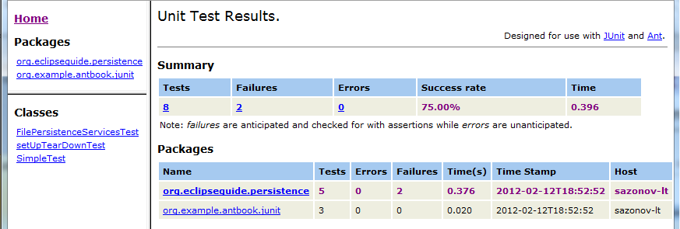
Generating (HTML) test result reports
Open C:\Antbook\ch04\build\test\reports\index.html
Test methods
Test cases
This is the generated main page, index.html, by <junitreport>.
It summarizes the test statistics and hyperlinks to test case details.
Notes:
the default frames

Slide 24
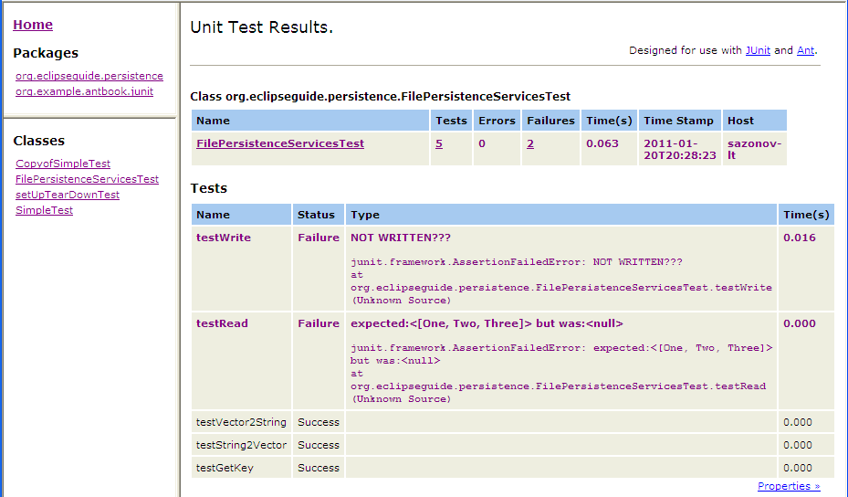
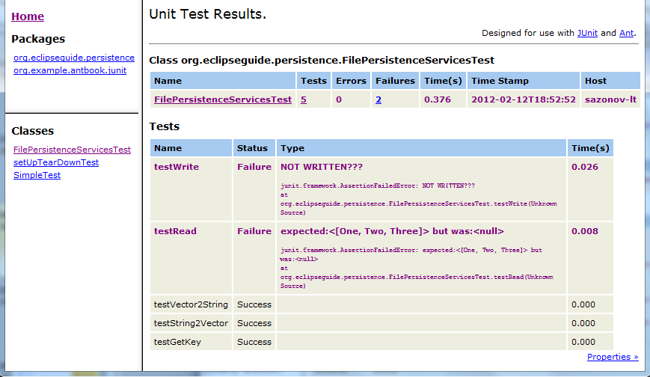
Generating (HTML) test result reports
Navigating to a specific test case FilePersistenceServicesTest displays:
A specific test
case results:
Test methods
and details of
corresponding
assertion that
failed are
clearly shown.
Clicking the Properties » shows all of Ant’s properties at the time the tests were run.

Slide 25
Generating (HTML) test result reports
Self-study
Clicking the Properties » above shows all of Ant’s properties at the time the tests were run.
These can be handy for troubleshooting failures caused by environmental or configuration issues.
NOTE. There are some issues with <junit> and <junitreport>:
<junit> has no dependency (uptodate) checking;
it always runs all test cases (even if they are not up to date).
<junitreport> simply aggregates all XML files without any knowledge of whether the files it is using have any relation to the tests just run. (They could be old.)
Use <uptodate> task (considered later) to ensure tests only run if things have changed.
Cleaning up the old test results before running tests gives you better reports.
Notes:
Fig. 4.6
??Requirements of <junitreport>???

Slide 26
Running a single test case from the command-line
Self-study
While a project can have many test cases, you may need to isolate a single test case to run when ironing out a particular issue.
This can be accomplished using the if/unless attributes on <test> and <batchtest>.
Our <junit> task evolves again:
Notes:
4.7.2

Slide 27
Running a single test case from the command-line
Self-study
<junit printsummary="no"
errorProperty="test.failed"
failureProperty="test.failed">
<classpath refid="test.classpath"/>
<formatter type="brief" usefile="false"/>
<formatter type="xml"/>
<test name="${testcase}"
todir="${test.data.dir}"
if="testcase"/>
<batchtest todir="${test.data.dir}" unless="testcase">
<fileset dir="${build.test.dir}" includes="**/*Test.class"/>
</batchtest>
</junit>
These minor additions
to our “test” target
make the required effect.

Slide 28
Running a single test case from the command-line
Self-study
By default,
testcase property will not be defined and, therefore,
the <test> will be ignored, and
<batchtest> will execute all of the test cases.
In order to run a single test case,
run Ant using a command line like
>ant test -Dtestcase=<fully qualified classname>
C:\Antbook\ch04>ant -f mybuild.xml clean test
-Dtestcase=org.example.antbook.junit.SimpleTest
TRY it and compare with the previous run and html result.
Notes:
ant -f mybuild.xml clean test -Dtestcase=org.example.antbook.junit.SimpleTest
OMITTED: -Dbuild.debug=on

Slide 29
About testing again
Now, having Ant and JUnit tools, we can summarise how test-driven programming can be done:
Writing and automated running test cases may actually improve the design of our production code.
In particular, if you cannot write a test case for a class, you have a serious problem, as it means you have written untestable code.
Hope is not lost if you are attempting to add testing to a large system on later stages .
Do not attempt to incorporate test cases for the existing code in one big go.
Notes:
(that was built without unit tests in place)

Slide 30
About testing again
Before adding new code, write tests
to validate the current behaviour
to describe (specify) the expected behaviour on new code to be added, and
to verify that the new code
does not break the current behaviour
and demonstrates the correct new behaviour.
When a bug is found,
write a test case or a test method to identify it clearly, then
fix the bug and watch the test passes.
While some testing is better than no testing,
a critical mass of tests needs to be in place to truly realize such XP benefits as fearless and confident refactoring.
Keep at it and the tests will accumulate little-by-little allowing the project to realize these and other benefits.

Slide 31
Extensions to JUnit
Partly discussed earlier.
Self-study
It is easy to build extensions on top of JUnit.
There are many freely available extensions and companions for JUnit.
This table shows a few:
Name | Description
HttpUnit | A test framework that could be embedded in JUnit tests to perform automated web site testing.
JUnitPerf | JUnit test decorators perform scalability and performance testing.
Mock Objects | Allows testing of code that accesses resources such as database connections and servlet containers without the need of the actual resources.
Cactus | In-container unit testing. Covered in detail in chapter 12 of Ant book.
DBUnit | Sets up databases in a known state for repeatable DB testing.
Notes:
4.3.7 Table 4.1
Because of its architecture, it is easy to build extensions on top of JUnit.

Slide 32
BRIEF SUMMARY to Ant+JUnit
JUnit is Java’s de facto testing framework;
it integrates tightly with Ant.
<junit> Ant task
runs tests cases,
captures results in various formats (e.g. XML),
can set a property if a test fails.
<junitreport> Ant task with <report> sub-task
generates HTML test result reports (from XML),
Notes:
allows for customization of the reports generated via XSLT
4.10
Unit testing makes the world a better place because it gives us the knowledge of a change’s impact and the confidence to refactor without fear of breaking code unknowingly. Here are some key points to keep in mind:
Information can be passed from Ant to test cases via <sysproperty>.???

Slide 33
BRIEF SUMMARY to Ant+JUnit
There is a lot more on Ant and JUnit what we had no time to discuss.
Read Ant book and other materials presented in the Web site of COMP220.
Notes:
4.10
Unit testing makes the world a better place because it gives us the knowledge of a change’s impact and the confidence to refactor without fear of breaking code unknowingly. Here are some key points to keep in mind:
Information can be passed from Ant to test cases via <sysproperty>.???

